Slide 1
Cornerstone City Church Peninsula Plus Community Hoo Are Ya 05-03-2023

Slide 2
We are Marching
CCLI Song # 320947
Anders Nyberg | Andrew Maries
© 1987, 1991 Peace Of Music Publishing (Admin. by Sovereign Music UK)
Sovereign Music UK
For use solely with the SongSelect® Terms of Use. All rights reserved. www.ccli.com
CCLI Licence No. 33265

Slide 3
1/4
We are marching in the light of God
We are marching in the light of God
We are marching in the light of God
We are marching in the light of God

Slide 4
2/4
We are marching, marching O-oh
We are marching in the light of God
We are marching, marching O-oh
We are marching in the light of God

Slide 5
3/4
We are living in the love of God
We are living in the love of God
We are living in the love of God
We are living in the love of God

Slide 6
2/4
We are living, living O-oh
We are living in the light of God
We are living, living O-oh
We are living in the light of God

Slide 7
4/4
We are moving in the power of God
We are moving in the power of God
We are moving in the power of God
We are moving in the power of God

Slide 8
2/4
We are moving, moving O-oh
We are moving in the power of God
We are moving, moving O-oh
We are moving in the power of God

Slide 9
My Redeemer Lives
CCLI Song # 2397964
Reuben Morgan
© 1998 Hillsong Music Publishing Australia (Admin. by Hillsong Music Publishing UK)
For use solely with the SongSelect® Terms of Use. All rights reserved. www.ccli.com
CCLI Licence No. 33265

Slide 10
1/4
I know He rescued my soul His blood has covered my sin I believe I believe My shame He's taken away My pain is healed in His name I believe I believe
I'll raise a banner 'Cause my Lord has conquered the grave

Slide 11
2/4
My Redeemer lives
My Redeemer lives
My Redeemer lives
My Redeemer lives

Slide 12
3/4
You lift my burdens
I'll rise with You
I'm dancing on this mountain top
To see Your kingdom come

Slide 13
4/4
My Redeemer lives
My Redeemer lives
My Redeemer lives
My Redeemer lives

Slide 14
Everlasting God
CCLI Song # 4556538
Brenton Brown | Ken Riley
© 2005 Thankyou Music (Admin. by Integrity Music Ltd)
For use solely with the SongSelect® Terms of Use. All rights reserved. www.ccli.com
CCLI Licence No. 33265

Slide 15
1/3
Strength will rise as we wait upon the Lord
We will wait upon the Lord
We will wait upon the Lord
Strength will rise as we wait upon the Lord
We will wait upon the Lord
We will wait upon the Lord

Slide 16
2/3
Our God You reign forever
Our Hope our strong Deliv'rer

Slide 17
3/3
You are the everlasting God
The everlasting God
You do not faint
You won't grow weary
You're the defender of the weak
You comfort those in need
You lift us up on wings like eagles

Slide 18
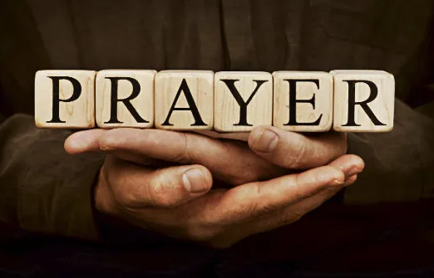

Slide 19
An Army Of Ordinary People
CCLI Song # 222241
Dave Bilbrough
© 1983 Thankyou Music (Admin. by Integrity Music Ltd)
For use solely with the SongSelect® Terms of Use. All rights reserved. www.ccli.com
CCLI Licence No. 33265

Slide 20
1/3
An army of ordinary people
A kingdom where love is the key
A city a light to the nations
Heirs to the promise are we
A people whose life is in Jesus
A nation together we stand
Only through grace are we worthy
Inheritors of the land

Slide 21
2/3
A new day is dawning,
A new age to come,
When the children of promise,
Shall flow together as one:
A truth long neglected,
But the time has now come,
When the children of promise,
Shall flow together as one

Slide 22
3/3
A people without recognition
But with Him a destiny sealed
Called to a heavenly vision
His purpose shall be fulfilled
Come let us stand strong together
Abandon ourselves to the King
His love shall be ours forever
This vict'ry song we shall sing

Slide 24
The Spirit of the Lord
CCLI Song # 2560753
Graham Kendrick
© 1997 Make Way Music (Admin. by Make Way Music Limited)
For use solely with the SongSelect® Terms of Use. All rights reserved. www.ccli.com
CCLI Licence No. 33265

Slide 25
1/2
The Spirit of the Lord
Is on me now
Poured out like oil over me
For the Lord has called
And anointed me
To preach good news to the poor

Slide 26
2/2
To bind the broken heart
To free the captive soul
Open blind eyes
Make broken people whole
And I know this is the hour
Of His favour and His power
And His Spirit is upon me now

Slide 28


Slide 29


Slide 30
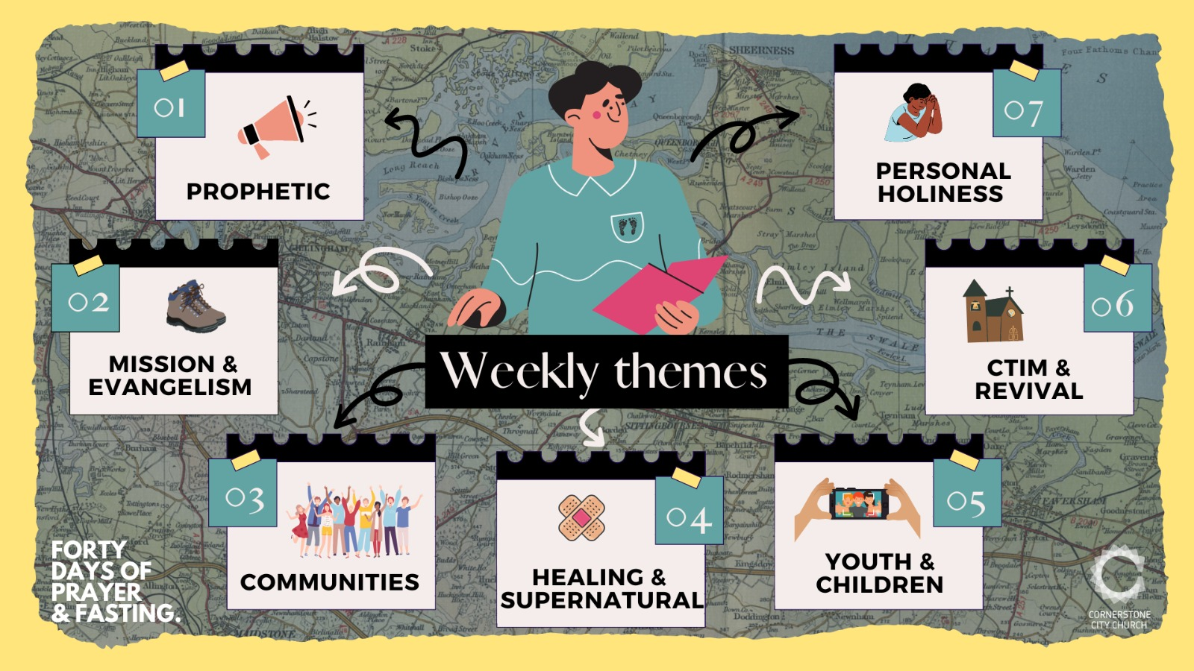

Slide 31
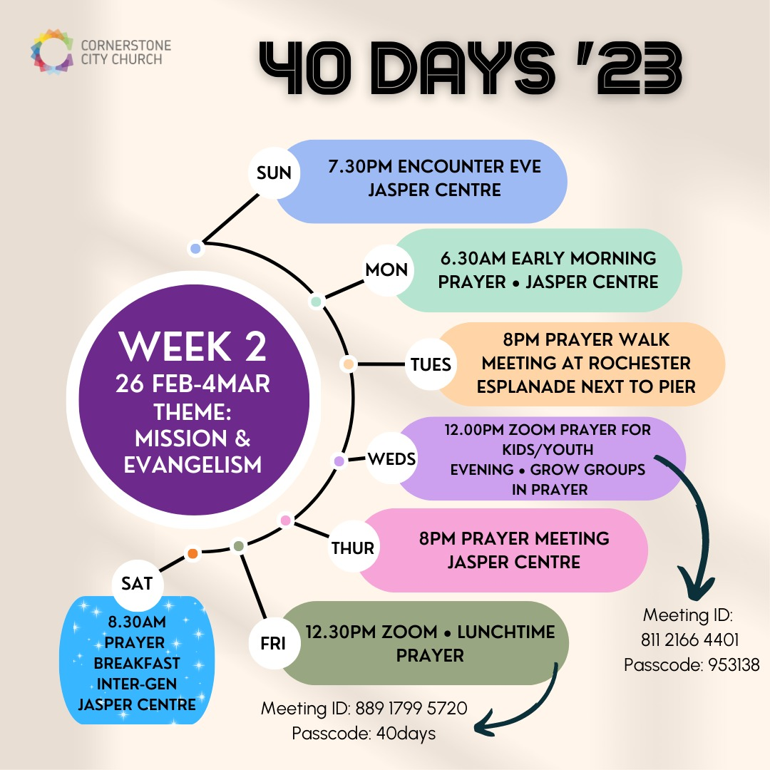

Slide 32
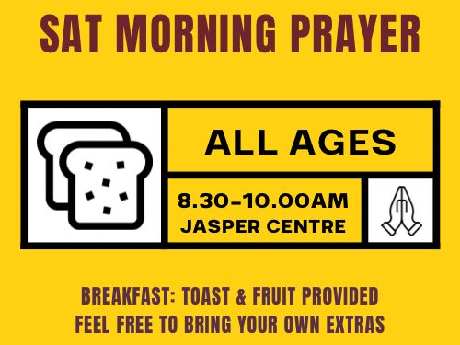

Slide 33
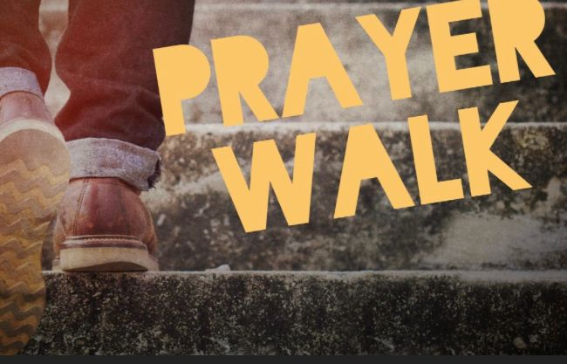

Slide 34


